Slide 1
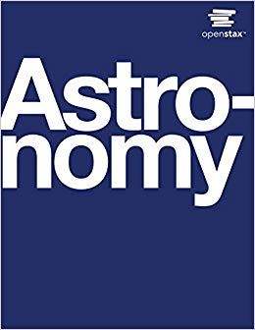
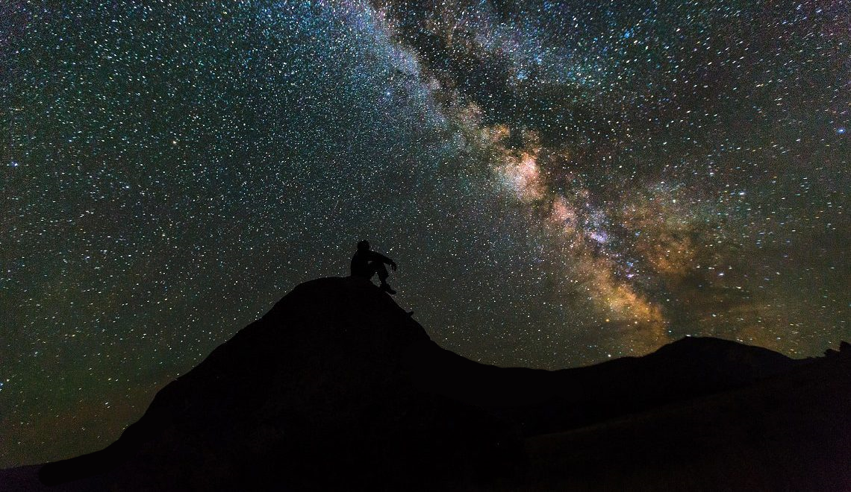
Introductory Astronomy (PHYS1010-01)
Unit 1: Radiation and Spectra (Part I)
Chapter 5.1 - 5.2

Slide 2
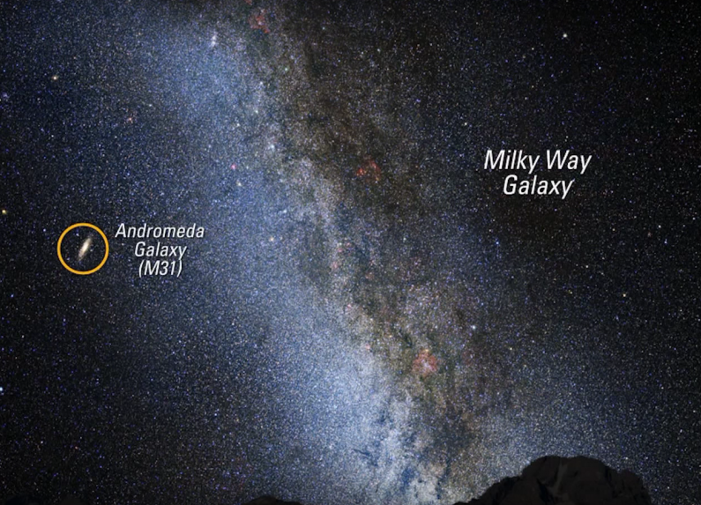
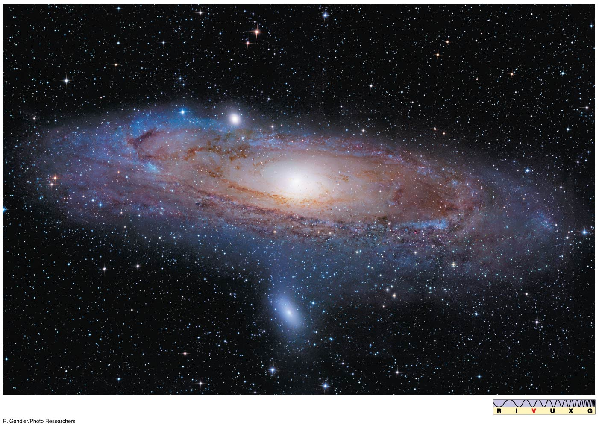
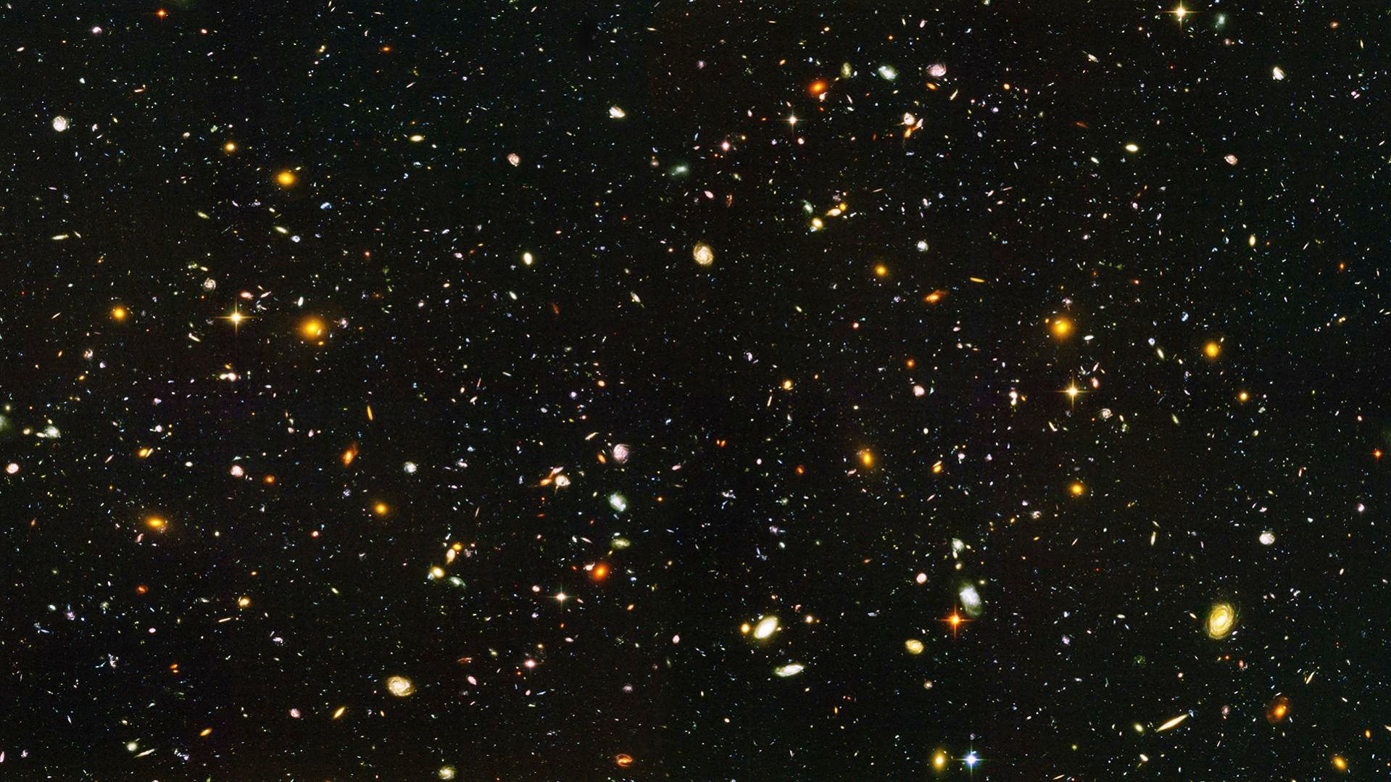
Andromeda Galaxy
(farthest object seen w unaided eye, 2.5 Mly away)
A lrg spiral galaxy ~120,000 ly across; ~1T stars &
at least 1 supermassive BH in core (mass ~140M_{ʘ});
mr thn (>)500 glob.clstrs; >30 sat gals orbit it…
…but physically inaccessible to us / spacecraft;
New Horizons → fastest spacecraft (V~60,000 km/h)
→ 450B yrs to reach it, 2.5M yrs to get info back!
B’s of galaxies exist much farther away…
How do we know anything about objects that far away?
We receive electromagnetic
radiation from them (eg. LIGHT)

Slide 3
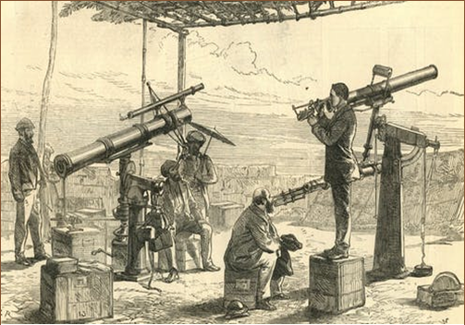
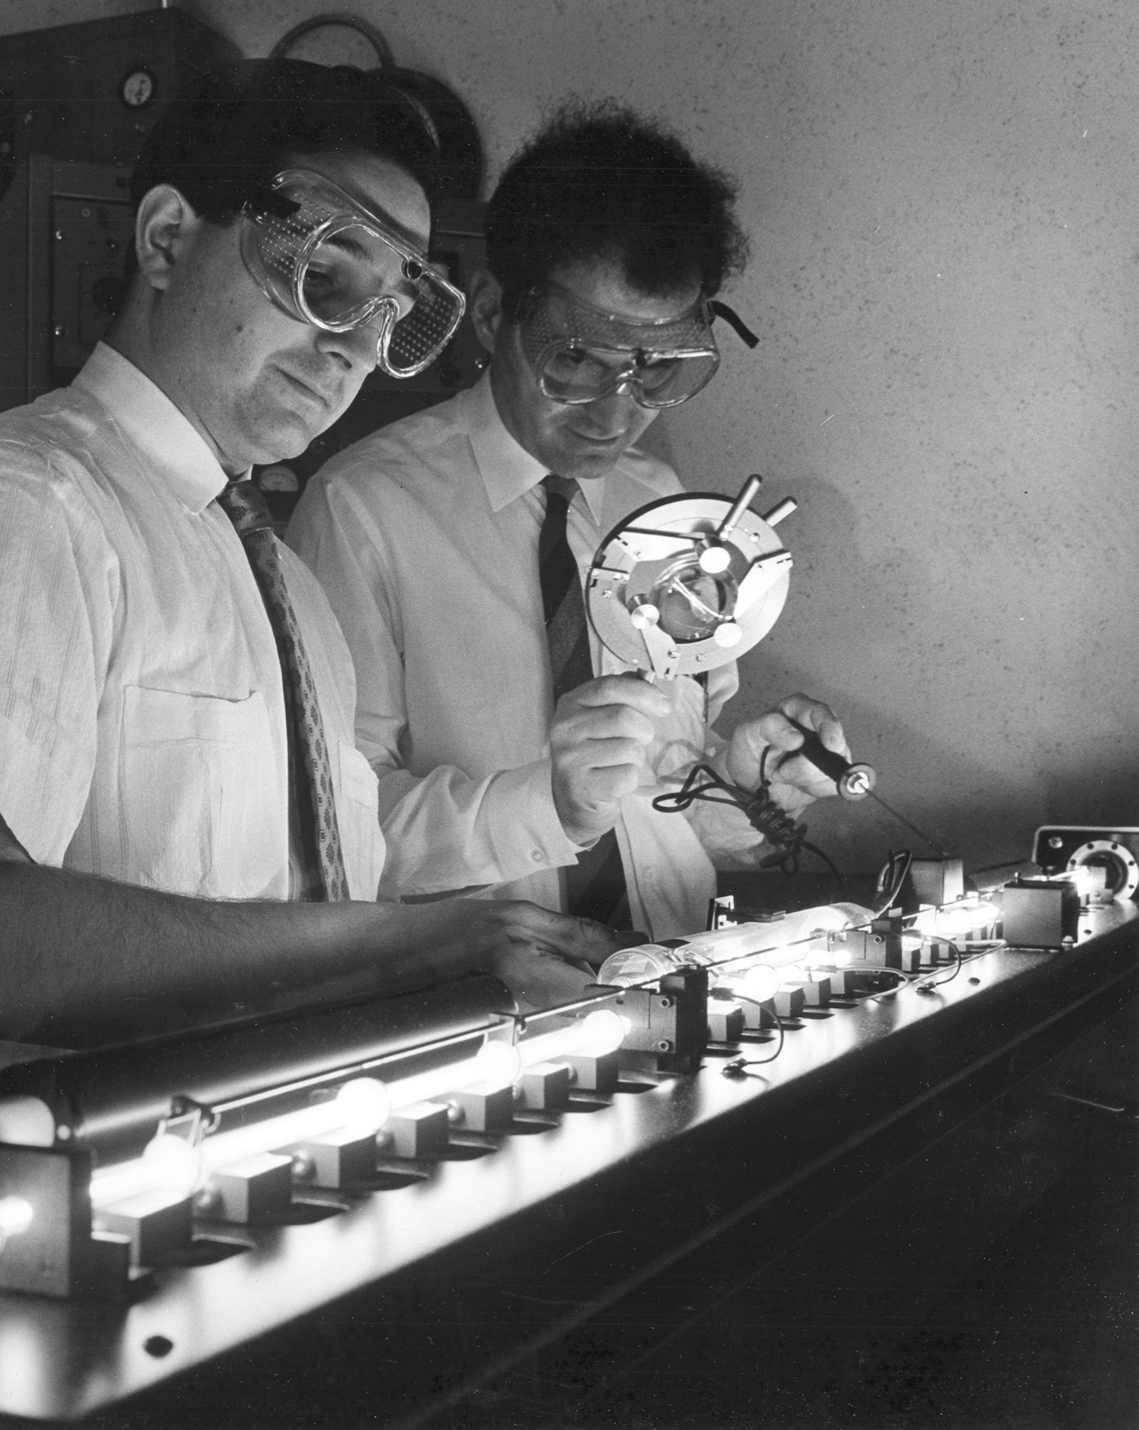
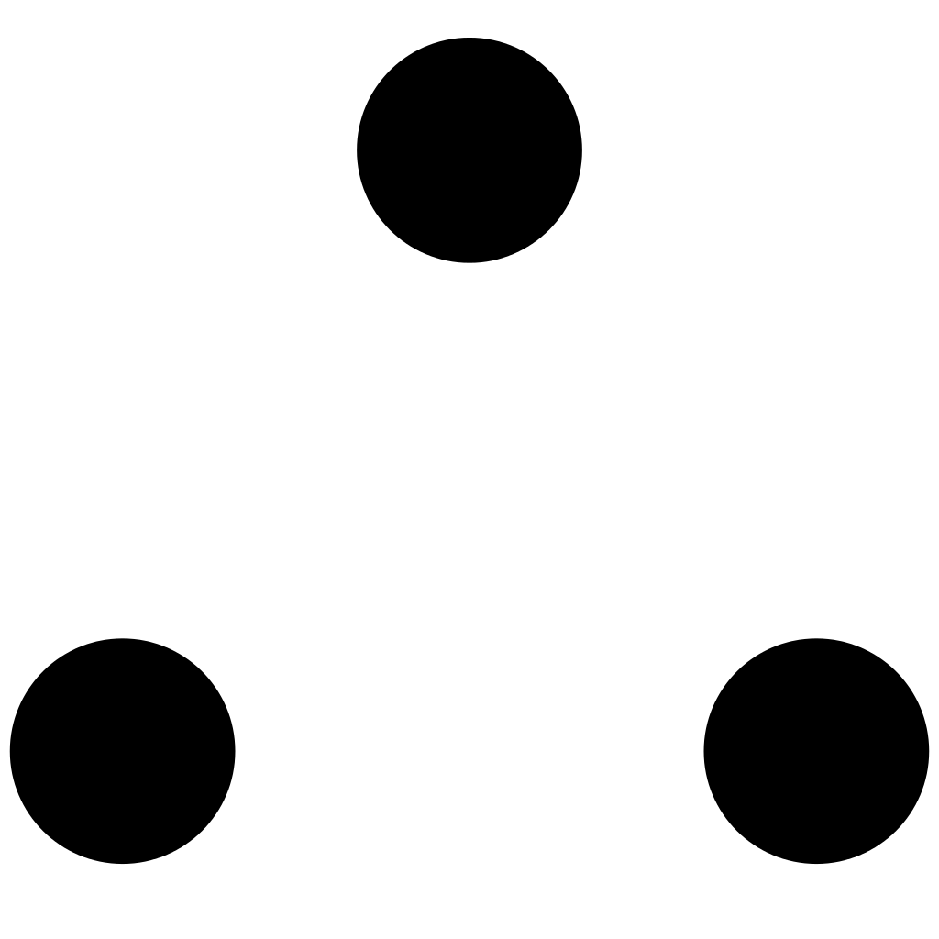
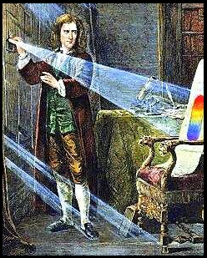
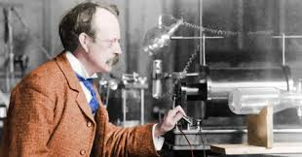
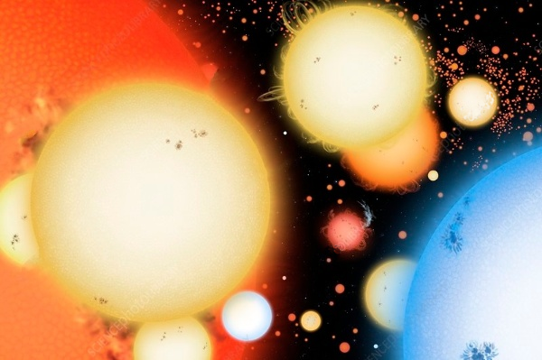
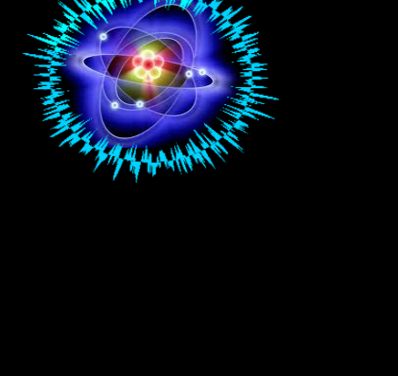
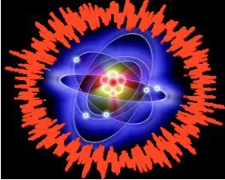
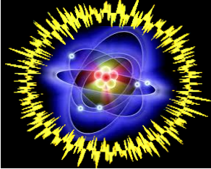

Over centuries, scientists learned tht
laws of ___________ discovered in
daily phenomena here on E apply
across lrgr/smllr ________(here & in space)
Use laws learned hr on E to
interpret the light & other types of
_______________________ given off
by these objects
Wide range of info cn be extracted frm EM radiation
( _______, size, ___________ , rotation,
_____________________ , etc.)
→ leads to undrstdng of processes @ work
inside/ outside emitting objects)
All forms EM radiation generated by processes @ __________ level
i.e.- chgs in way parts of atom ________ & move. to understand
what EM tells us abt planets/stars, mst look how _______ work.

Slide 4
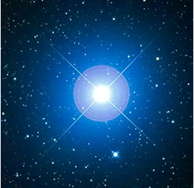
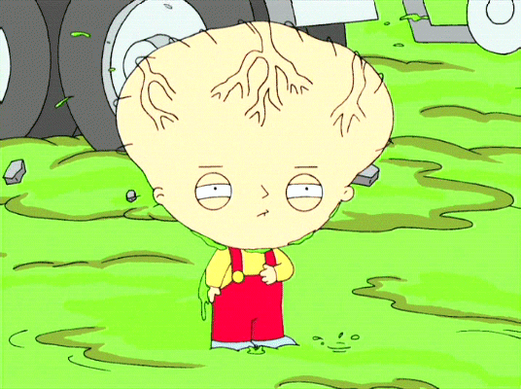
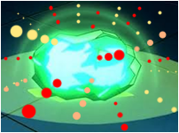
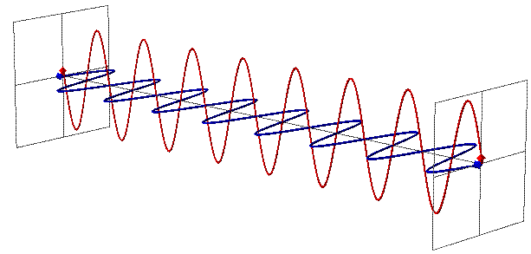
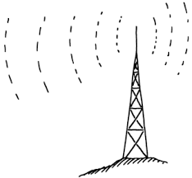
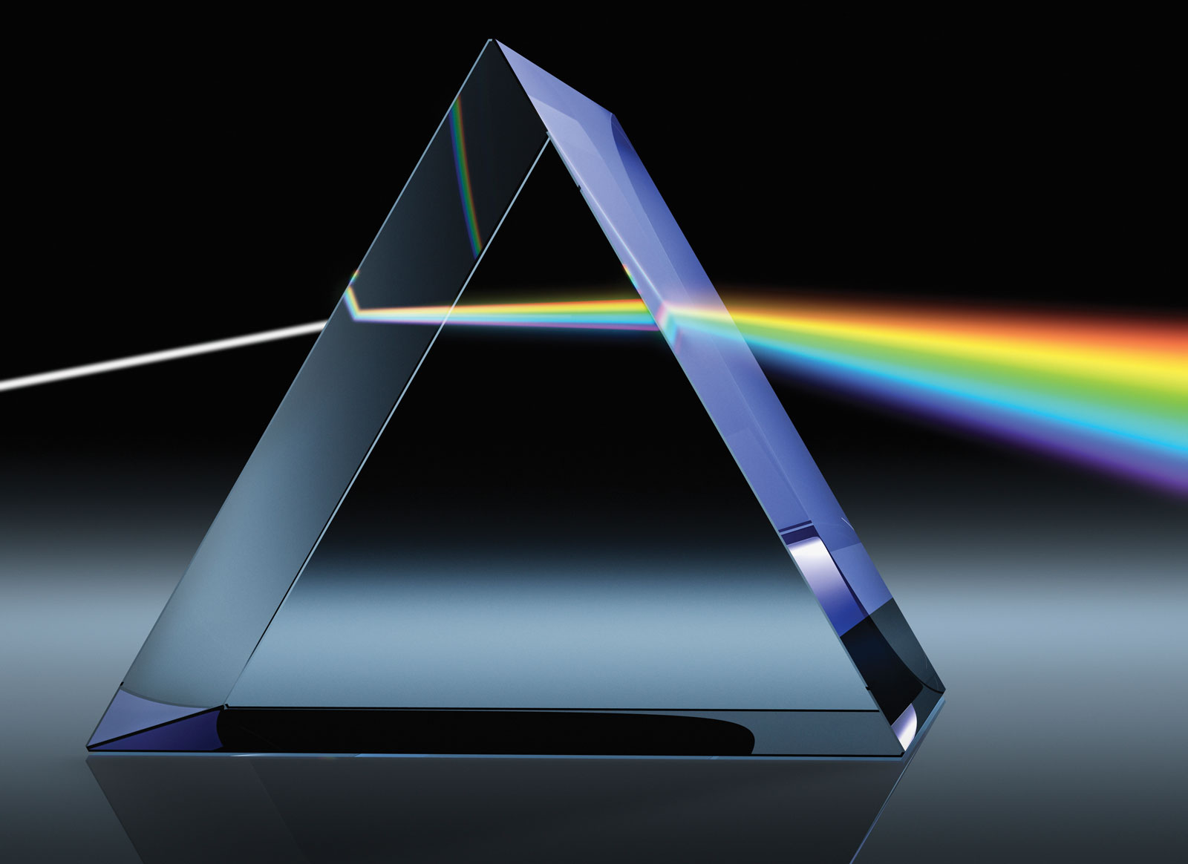
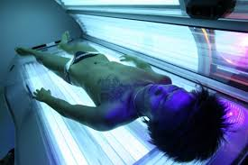
Information from the Skies
What is “Electromagnetic (EM) Radiation”?
Radiation:
A process by which energy
is transmitted frm a source to another pt in
space without need for any physical
connection ( “medium” ) btwn those 2 points.
________
___________
_________
*(not refering to subatomic particles released in “radioactive” radiation)
Electromagnetic: Refers to a type of energy (eg. light) traveling in the
form of oscillating electric and magnetic fields (wave) that is given off by electrons inside atoms.
______
_______
Examples:
UV - Rays
Radio Waves
Visible Light
Notes:
4

Slide 5
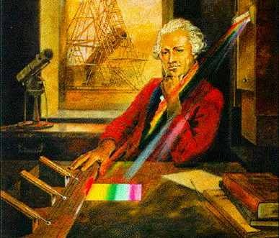
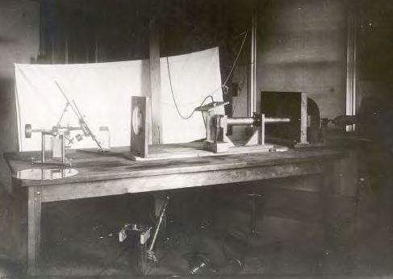
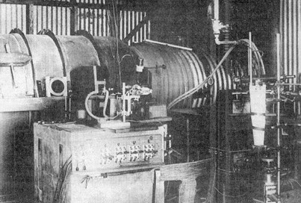
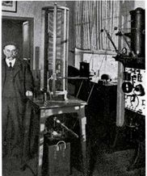
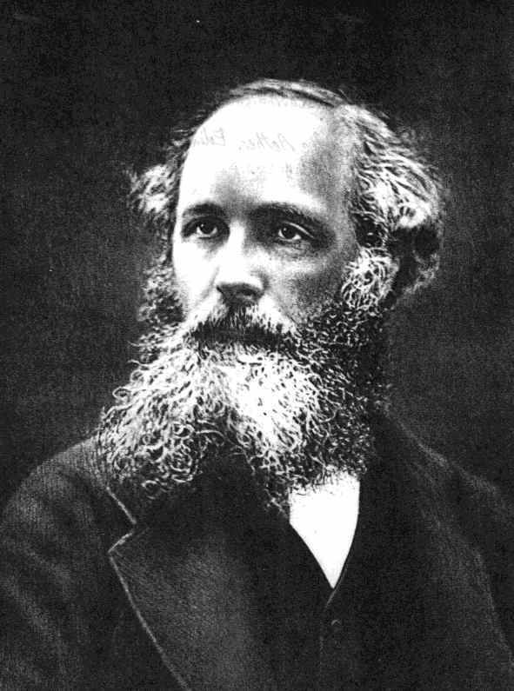
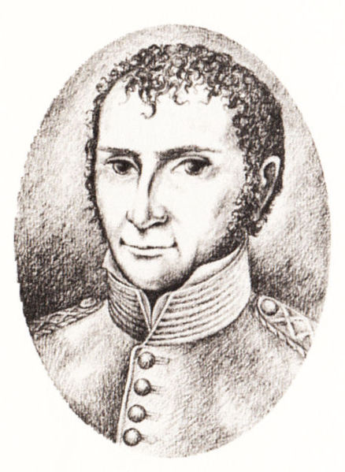
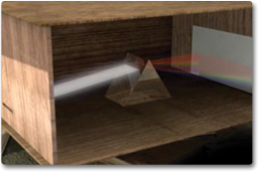
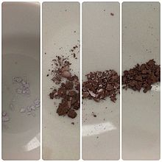
Discovery of Electromagnetic Waves
1) W. Herschel (1800) studied light w thermometer
1st to discvr new type energy:
infrared (IR) waves)
2) 1801 Johann Ritter discvrs
UV rays aftr reading abt
Herschel’s exprmts.
3) Other EM enrgy? Not until later
1800s, whn theory & experimntl
methds dvlpd engh to discvr them.
4) In particular, discvy of nature of electricity
& magntsm helped lead the way…
Up to 1830s – scientists like Gilbert, du Fay,
Guericke, B. Franklin, Coulomb, Orsted –
know that matter contains +/- charges
(Dvlp undrstding attrct/repel; conductors/
insulators, charges act like fluid – flowing
(current) bringing energy/ magnetic force)
5) James Clerk Maxwell
(Scottish mathm/
physicist) -1865
→ develops 1st
Theory of Electromagnetism;
unifying rules governing elect./
magnt. into 1 coherent theory…

Slide 6
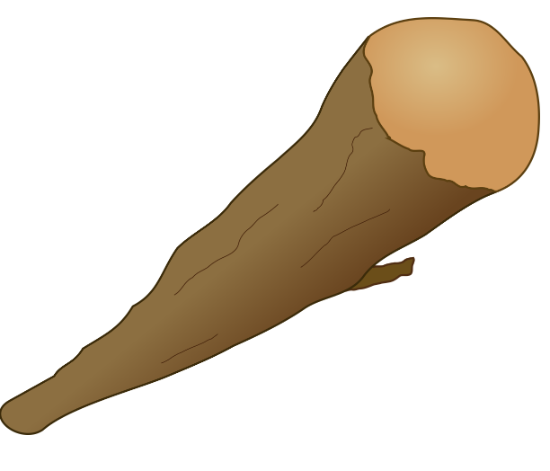


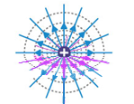
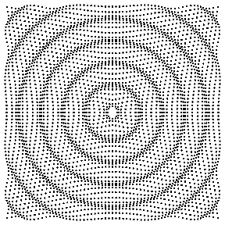

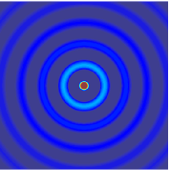

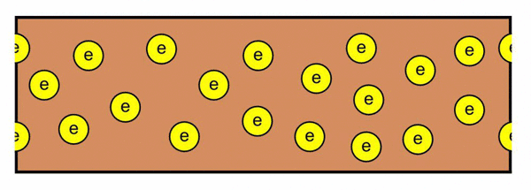
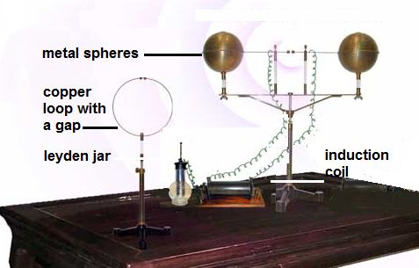
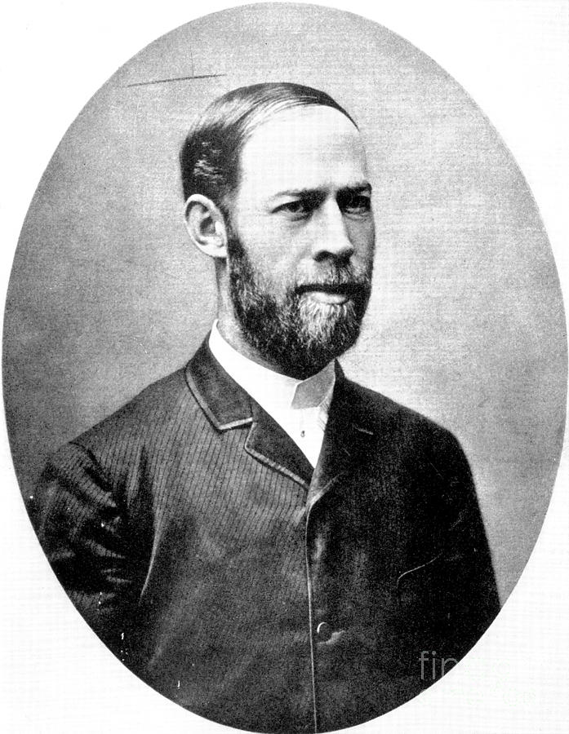
Maxwell’s Electromagnetic (EM) Theory
Matter consist of tiny invisible particles that contained
both + and – charges. (later “protons & electrons”)
When charges stationary, they exhibit an electric “force” field.
When charges mv uniformly (constant veloc.) they produce bth
electric and magnetic force fields. (perpendclr to ea. other)
Charges tht accelerate (speed ↑,↓, or change direction) make
electric/magnetic fields tht move & generate EM waves
A changing electric field creates a moving magnetic field
A changing magnetic field also creates a moving electric field.
Oscillating charges cause elec & mag fields to spread out
and away rapidly into space (create & radiate EM waves)
All EM waves travel at the same speed – the speed
of light (calculated to be 300,000,000 m/s
or 300,000 km/s) →(later shown) fastest speed there is.
1887 Heinrich Hertz
discovered radio waves &
proved Maxwell’s theory correct
Wire with
Alternating
Electric Current (AC)

Slide 7
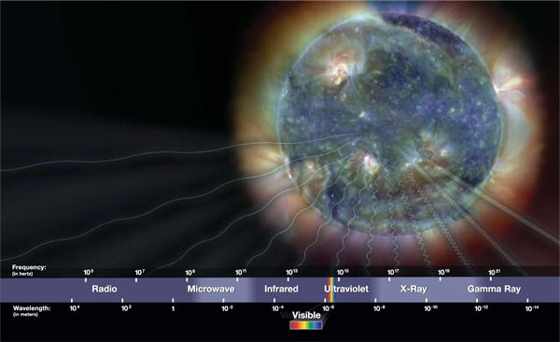

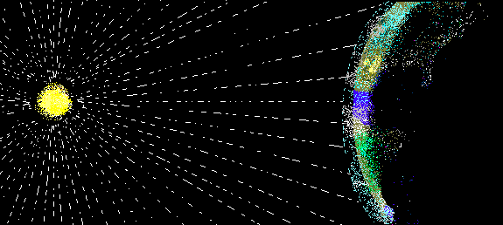

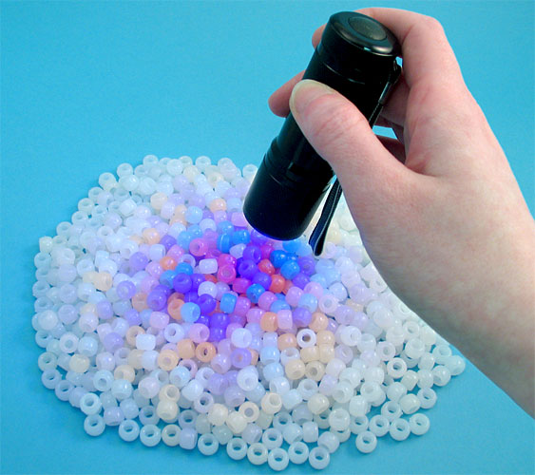
EM Waves
1888-1900: Other types of
EM rad discvrd…
scientists recognize all
types could travel thru
air & space in form of
waves
Challenging → EM waves invisible – detect only when they effect something

Slide 8
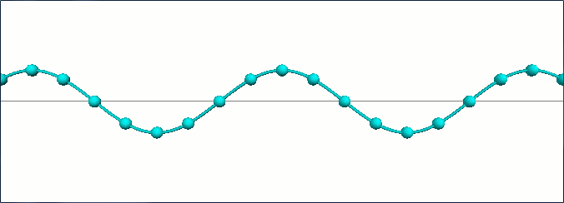
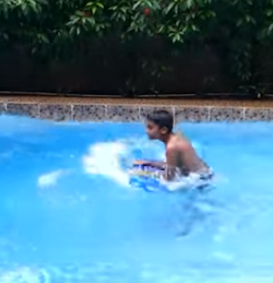
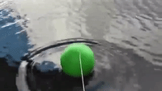
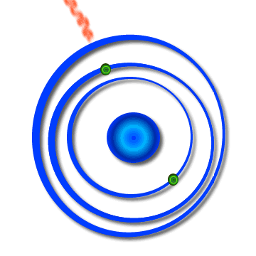
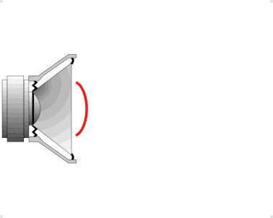
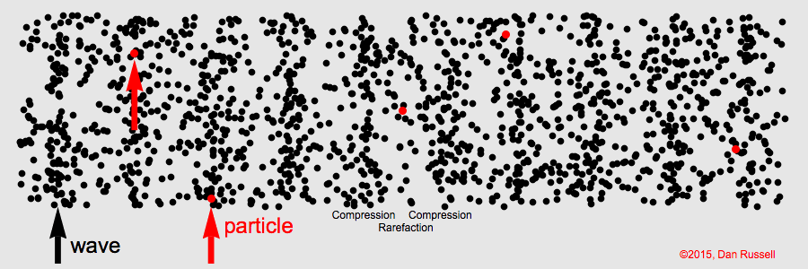
Ok, EM Waves Move Through Space…So What is a Wave?
Wave – (think abt water) - a disturbance in which energy is transferred from place
to place without physical movement of material from one place to another.
waves are usually
repetitive patterns
that originate with a
source that is
oscillating/vibrating
(repetitive cycles) as it
releases energy
Particles in
surface of H₂O
EM waves→created when atom
repeatedly absorbs/releases E

Slide 9
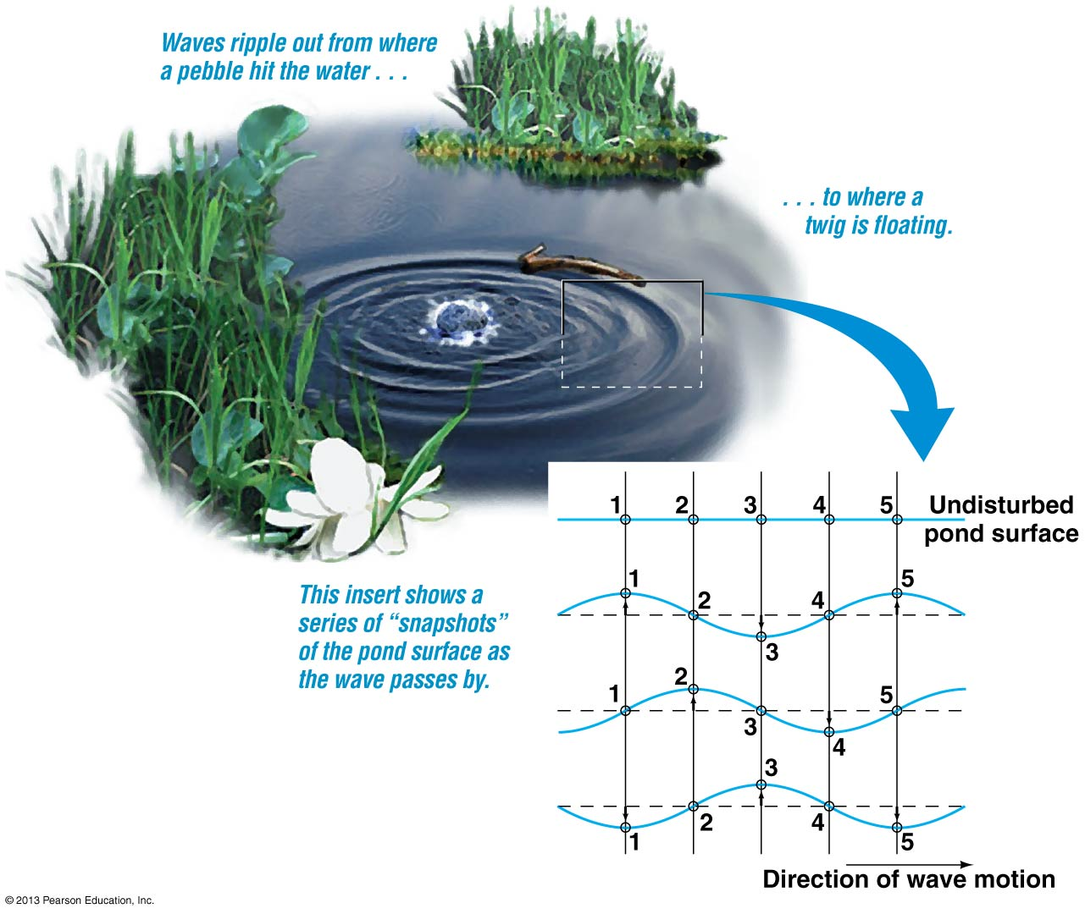

Consider ripples (waves) on a pond...
Initially the surface is flat - particles of H₂O undisturbed (also twig)
Rock thrown in disturbs particles of H₂O adding energy to them
Bc of attract.
btwn particles, ripples/waves form
t = 0s
-Water particles (+ twig)
just moves up and down,
transferring energy one to the
next by means of intermolecular
forces. Twig bobs (like particles,
no relocation)→
t = 1s
t = 2s
t = 3s
think: “arena wave”
Notes:
9

Slide 10
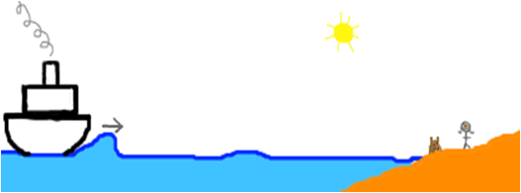
Wave disturbance travels and can transmit energy from impact
zone out to the edge
of the pond.
(True of any object
emitting waves)
Waves carry e from
a source to other
locations…
(eg. Sand castle on
a beach wrecked by wave
of a passing lg ship)

Slide 11
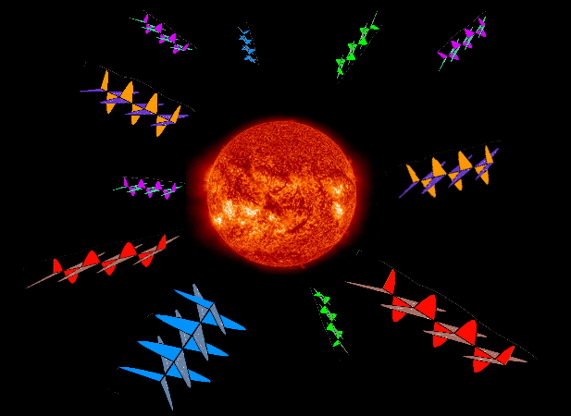
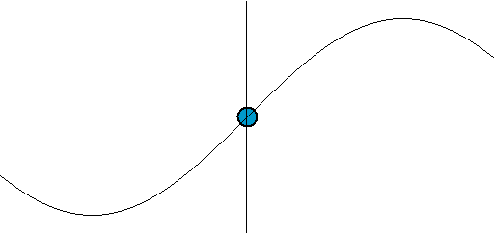
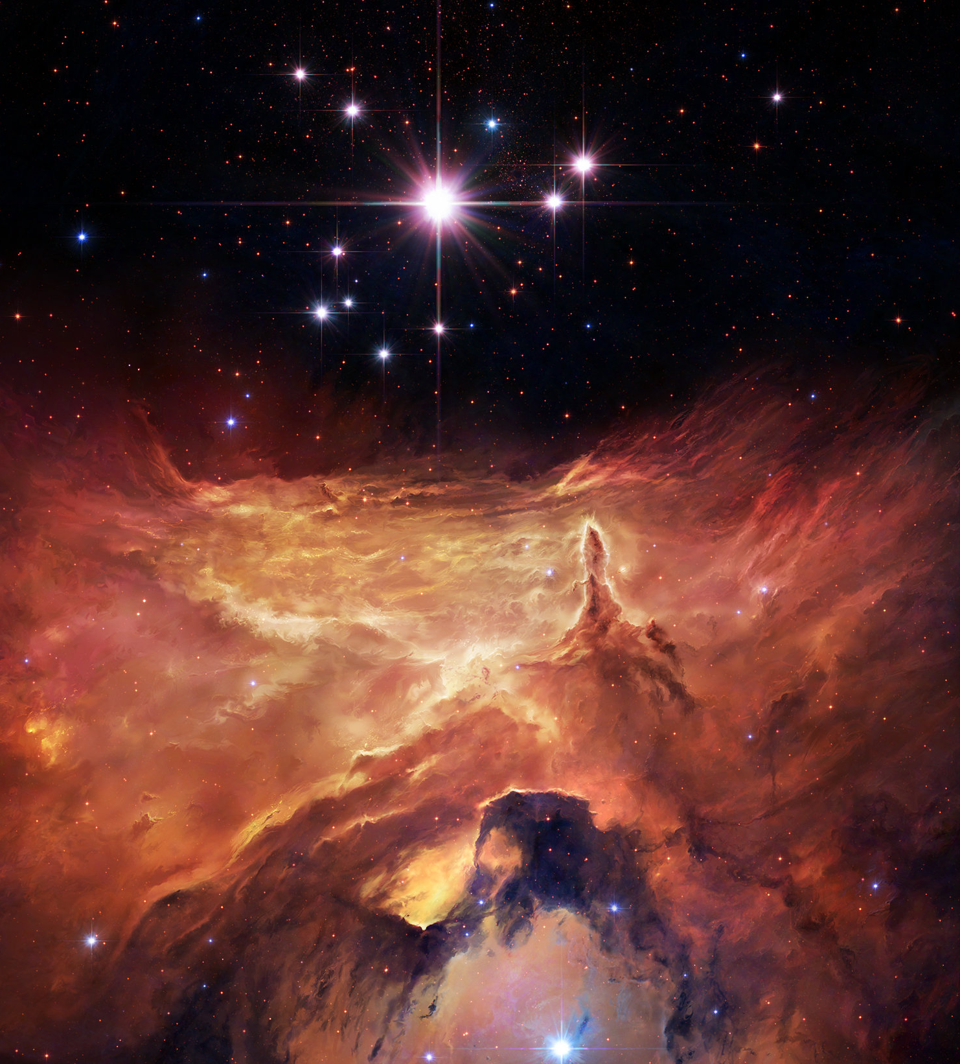


Wave not a physical object, but a movement of energy.
Up/dwn motion of particles (medium) caused them to vibrate abt rest position, but
E of disturbance eventually passes and they return to their same rest position.
Energy is moved along,
not the particles
Rest
line
----------------------------------------------------------------
Hwvr, EM Waves Different thn Other Waves:
Not like “mechanical” waves (sound, tidal waves, etc.)→bc EM
waves travel through space without need of a medium to
travel through. (they radiate outward differently)
Obviously, EM can travel thru a medium (eg. H₂O, air) as well…
vacuum of space (empty)

Slide 12






So Light/Other EM Waves Come From Atoms Within Stars & Other Objects
all EM wvs carry energy (E) to us frm
these objts, & the E results frm processes
occuring there…
…stdyng EM waves cn tell us mny things abt the
objects!
So, what cn we measure abt waves?

Slide 13

Wave Properties
Since waves are E disturbances that oscillate - how strong is the oscillation? →E frm source creates wave’s intensity
…in wv, E carried in crests & troughs;
size called “AMPLITUDE”
Crest size = Trough size
1 wavelength
Amplitude
Since waves occur in repetitive patterns,
different types of waves cn be characterized by the distance (length) it takes
for 1 complete pattern (1 oscillation) (eg. From X → X)
Known as “Wavelength” (λ) – (units: km-m-nm)
Notes:
13

Slide 14


Another Characteristic: the rate at which waves go by...
Frequency: Number of complete waves or cycles (wavelengths) that
pass a given point per second (c/s = Hz)
Consider 3 diffrnt waves:
f = 1 wavelength (c)
passes in 1 s
f = 1 c/s = 1 Hz
f = 1.4 wavelengths (c)
pass in 1 s
f= 1.4 c/s = 1.4 Hz
All waves move this way, at
same speed.
f = 3.3 wavelengths (c)
pass in 1 s
f = 3.3 c/s = 3.3 Hz
# cycles c
total time s
f =
= Hz
Frequency related to
Wavelength
So, if 6 complete waves pass by in 3s… f = 6 c
3 s
= 2c/s = 2 Hz
Notes:
14

Slide 15


How Long Does It Take For 1 Wave to Go By?
Period: Time between the passage of successive
crests or succesive troughs
(Play slideshow
for animation)
Period = time needed (s)
(T) # complete waves (c)
(measured in seconds)
So, if buoy crests 2 consecutive waves 10s apart, then
2 complete wave patterns pass the buoy every 10s…
T = 10 s
2 c
= 5 s
1 c
T = 5s The period of the waves is 5s.
Alternately, if 6 consecutive waves passed under the buoy in
15 seconds…
T= 15s = 2.5s
6c 1c
T = 2.5s The period of the waves is 2.5s.

Slide 16

Period and Frequency are Related
Period (T) and Frequency (f) are mathematically reciprocals of eachother……
f = hz =c while T = s → f = 1 or T = 1
s c T f
Example Problem: 5 waves take 10 seconds to pass a boat in a
lake. What is the frequency of the waves?
What is the period of the waves?
f= # cycles
time taken
T = time taken
# cycles
f= 5 waves (c) = 5 c = 1 Hz T = 10 s = 2 s = 2s
10 s 10 s 2 5 c 1 c
Notes:
16

Slide 17

We can measure the velocity (speed) of a wave by using some of these properties…
Velocity = distance travelled (km → m ) …
time taken h s
Let’s use λ as the distance travelled...
Period (T) of wave is time it takes for 1 wave to go by (2s). From crest to crest the wave is 5m long.
λ
t = 2s
Universal Wave Equation
V= λ
T
So, V = λ = 5 m = 2.5 m/s
T 2s

Slide 18
But we learned that
f = 1/T , so substitute f in for 1/T in the equation and you get…
λ
V = f x λ
Another way to look at it… if V= λ → V= 1 x λ
T T
(So what is the frequency?)
So…. V = ½ c x 5m = 2.5 m/s
s c
f =1Wave = ½ c
2s s
= λ
T
So Universal Wave Equation: V or V = f x λ

Slide 19


How Did Scientist Come to Decide Light is a Wave?
Through careful study, saw that light showed similar behaviour to waves here on earth.
Diffraction: The bending of a wave around an obstacle
Interference: The sum of two waves; may be larger or smaller than the original waves
Constructive/Destructive
Notes:
19

Slide 20


Examples of Diffraction & Interference of Waves in Water
Diffraction: The bending of a wave around an obstacle
Interference: The sum of two waves; may be larger or smaller than the original waves
These wave behaviours not easily detected with light - happen on a very small scale (& light waves not visible as waves)…

Slide 21


Evidence of Light Showing Wave Properties
Light diffracts around small ice crystal in high altitude clouds creating what is called a lunar corona effect.
Lunar Corona
(diffraction)
The interference of a specific frequency of coherent light waves with one another set creates a complex pattern which our eyes interpret as a hologram.
Holograms
(Interference)
Seeing these behaviours gave scientists confidence that light was indeed a type of wave.

Slide 22







Confusion About Light’s Nature..
Light still confused scientists into late 1800’s…
-followed Newton’s proposal of a kind of medium in
space which light traveled through: “Aether”
Maxwell, Michelson, Morely et al, exprmnts debunked
aether theory →space was a vacuum (empty)
Confusion - how could light travel in space?
Frm mid-1800s, some expmts supported idea that light
was a stream of energy particles (reflection/refraction/ Photoelectric Effect)
PHOTON – a “particle” of light Different colours,
→ a self-contained packet of energy dffrnt quantities
of energy (quantum)
(1905) Albert Einstein’s general
theory of relativity showed tht light
travels as both a wave & a particle. In space it travels like a bullet shot out in every direction frm objects – but also behaves as a wave.
Need particles (medium) to travel in
Travel in vacuum, water, air, etc

Slide 23

So How Are Electromagnetic Waves Generated?
Recall: EM radiation - set of oscillating magnetic and electric fields
given off by electrons inside atoms.
How are the oscillating fields created?
Proton (+) interacts with Electron (-)
Has to do with electric/magnetic force field that exist around electrons & protons. These force fields interact when these particles are close (inside an atom)

Slide 24

Back to Highschool → Structure of the Atom:
Electrons
→ tiny “-” charged particles orbiting nucleus
→ what gives electron the charge?
→ An electric/magnetic “force field” - like gravitational force field
but can pull and push
Atomic Structure
Electrons: - charge; 1/2000
mass of Proton
Nucleus
Protons: + charge;relatively
massive
Neutrons: neutral, relatively
massive

Slide 25

Electron’s Force Field
Just like gravity → force field increasingly weakens as you move away from the electron.
Note: black field lines get farther apart as you move away/ closer as you approach Electron.
Denser the lines, stronger the electrical field around the electron.
( as you get closer to the electron, electric field grows stronger).

Slide 26


(Play slide to see animation…)
Electric fields of proton & electron interact in specific way while the electron stays in a specific energy level (“orbital”).
Interacting fields create a type of “electrical potential” pattern.
“Electrical potential pattern” → a type of “stored energy” pattern.
As long as the electron does not change its orbit, the pattern or energy state is maintained.

Slide 27

Electron orbiting nucleus can absorb energy→ changes orbit
When electron changes position around nucleus, this causes its electric field to interact differently with + force field of nucleus → changes e¯’s electric field → disturbance in the field is given off as oscillating electric field which also generates a matching magnetic field.

Slide 28
Here you can see the oscillating electric field given off by the electron (red) and the matching magnetic field that is created (blue). They are equal in strength (amplitude), wavelength and speed as they travel away from the electron.
This makes an electromagnetic wave…

Slide 29


Magnetic and Electric Fields Closely Related
Bc of origin, Mag & Elect fields are always connected with eachother…
See evidence for this not only w electrons but in many commonly
seen phenomena:
Eg. A magnetic field, such as the Earth’s shown here, exerts a force on a moving charged particles (such as
those thrown out by the sun in its
solar wind. Those electrically charged
particles close to the earth are pulled
in, slam into upper atmosphere and
cause aurorae (northern/southern
lights).
Notes:
29

Slide 30




Magnetic Fields Interact with Electric Fields
Magnetic fields were used in TV picture tubes to deflect – charged electrons...
Moving electric fields also generate their own magnetic fields....
Motors!
Notes:
30

Slide 31

Electromagnetic Spectrum
Look at beam of white light...actually a mixture of colours (rainbow) → ROYGBIV
We can break white light into its component colours using a prism
In reality, not 7 colours, but millions – including all non-visible radiation the waves are called →EM SPECTRUM
Visible light waves fall into wavelength range of
400nm (Violet) to 700nm (Red) – eyes
Most sensitive to Yellow/Green 550nm

Slide 32
The Electromagnetic Spectrum
Different colors we see are interpretations by our eyes of the different EM waves of light. Colours are distinguished by their frequency and wavelength.
The visible spectrum is only a small part of the total electromagnetic spectrum.
Notes:
32

Slide 33

The Electromagnetic Spectrum
Different parts of the full electromag-
netic spectrum have different names, but there is no limit on possible wavelengths.
Type of EM Radiation
Size of wavelength
Notes:
33

Slide 34
Atmosphere blocks most radiation from space but there are some frequencies that make it all the way to the ground…visible light, some infrared waves, some microwaves and a lot of radiowaves from space get in…

